Slide 1

covid19: Data modeling by machine learning
Catherine Diagama-Pedroza
Alfredo A españa R

Slide 2
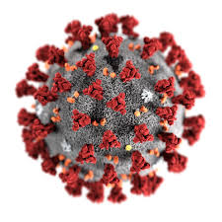
Coronavirus (COVID-19) is an illness caused by a virus that can spread from person to person. The virus that causes COVID-19 is a new coronavirus that has spread throughout the world. The number of new COVID-19 cases reported continues to grow, particularly in the southern and western regions of the country. Over the past 2 weeks, the national 7-day average of new daily cases has risen more than 60 percent, according to 91-DIVOC, a tracking site powered by data from the John Hopkins Center for Systems Science and Engineering (JHU CSSE). Over the same time period, the national mortality rate from COVID-19 has remained relatively stable, but that might be starting to change
Coronavirus (COVID-19)

Slide 3



covid19: Data modeling by machine learning
Sources of the data

Slide 4




ETL process
For this project 3 different files were used to implement a machine learning model that can predict the death rates with data from people infected and recovered. Also a population file was used in order to obtain the population numbers to standardize the data.
Get the population by country a standardized the data for 1 million por person
Delete and rename columns in each data set
covid19_model_Df
Select the country to make the data frame going to be used in the analysis
Rename and reshape the data frame to fit the model .

Slide 5




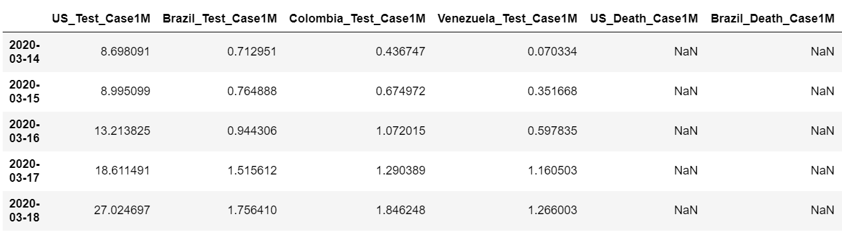
ETL process
Covid19_model_Df
Test
Death
Recovered

Slide 6
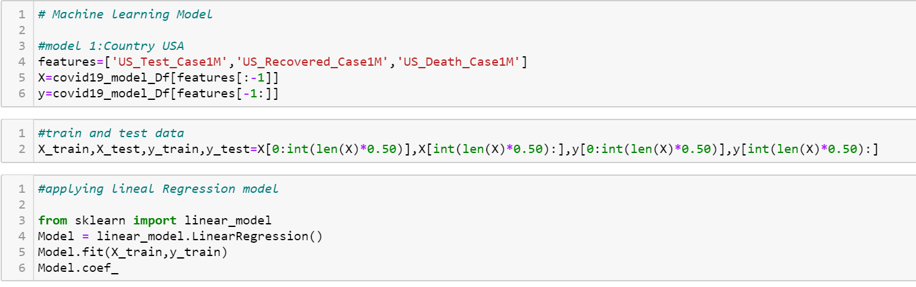
Lineal regression model
Using the infection and recovered rate to predict the death rate in U.S.A, Colombia and Brazil

Slide 7
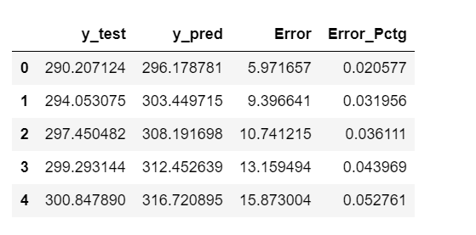
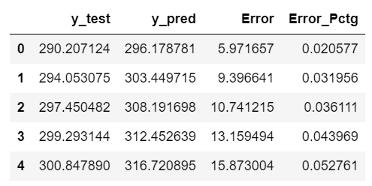
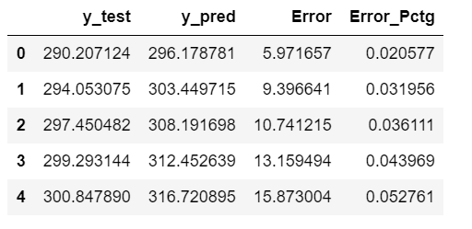
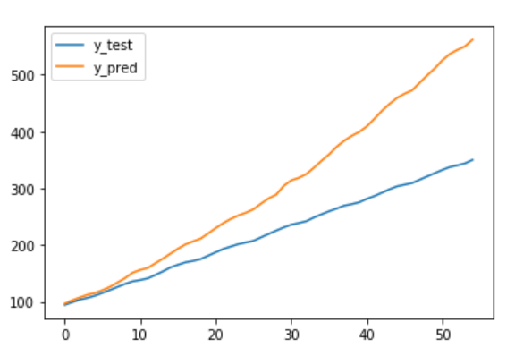
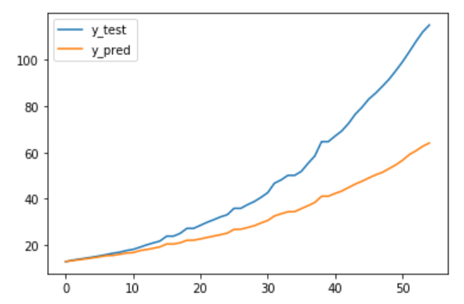
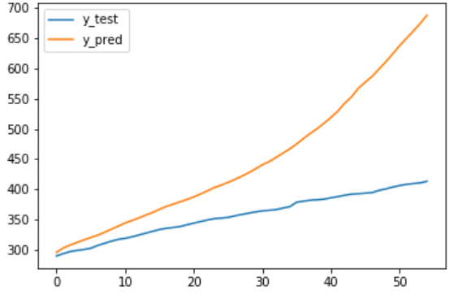
Lineal regression model: Using the infection and recovery rate to predict the death rate in U.S.A, Colombia and Brazil
U.S.A
Brazil
Colombia

Slide 8
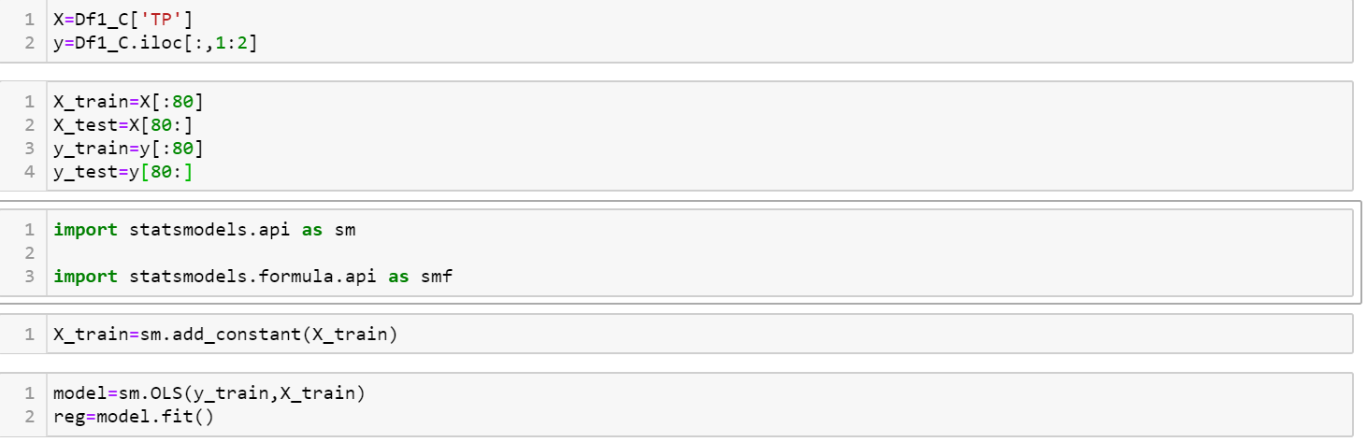
Lineal regression model:
Using the period of time to predict the number of infection in U.S.A, Colombia and brazil

Slide 9
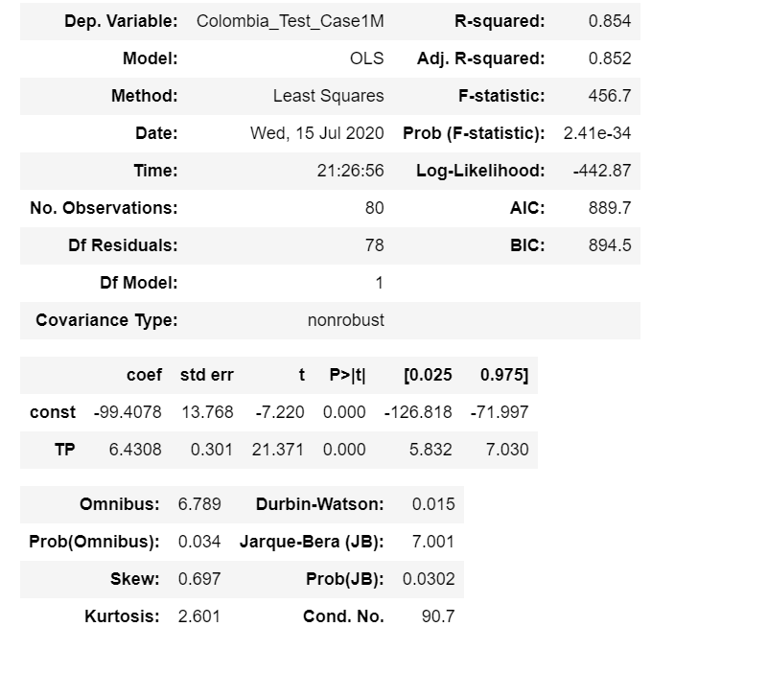
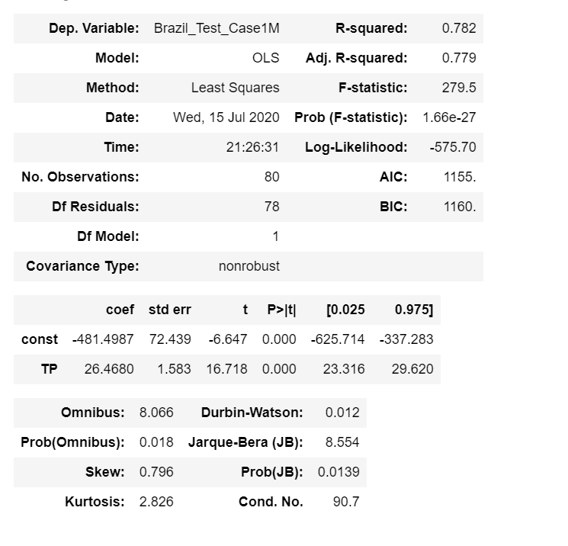
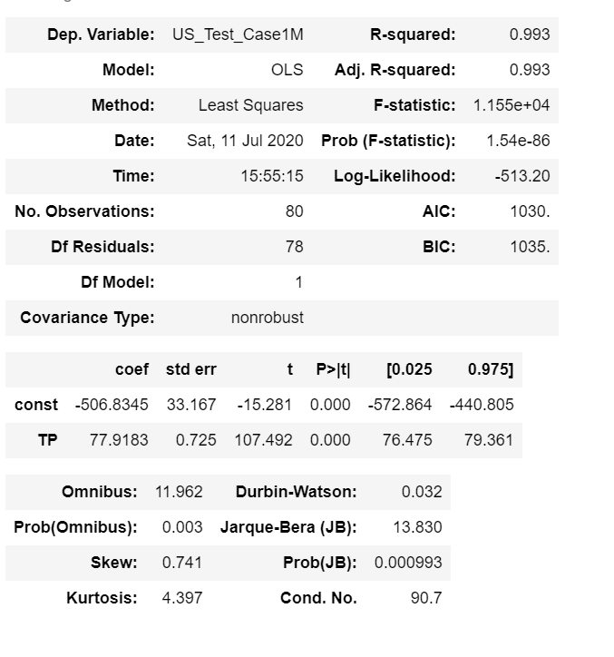
Lineal regression model: Using the period of time to predict the number of infection in U.s.A, Colombia and brazil
U.S.A
Brazil
Colombia

Slide 10
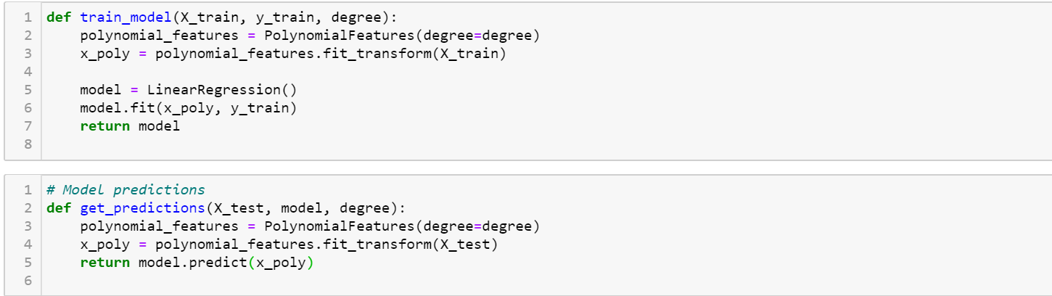
polynomial regression model
Using the period of time to predict the number of infection in USA, Colombia and brazil

Slide 11
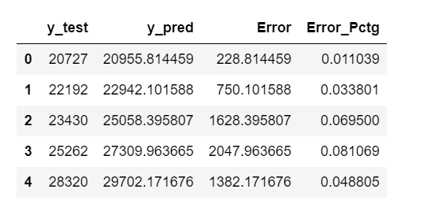
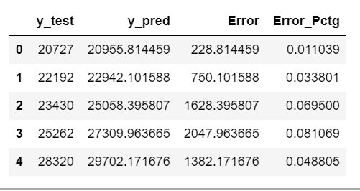
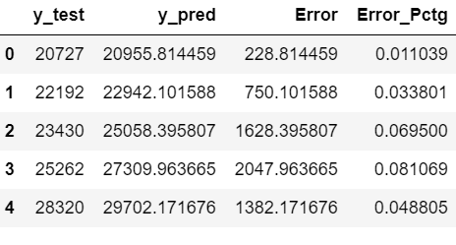
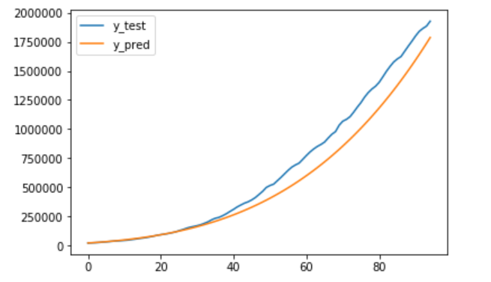
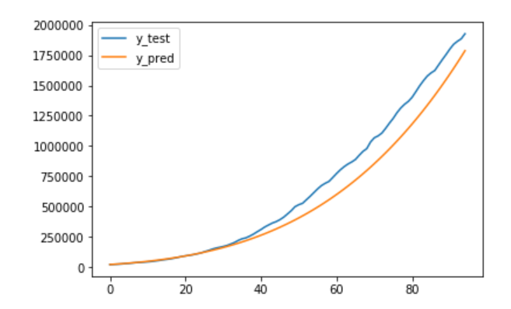
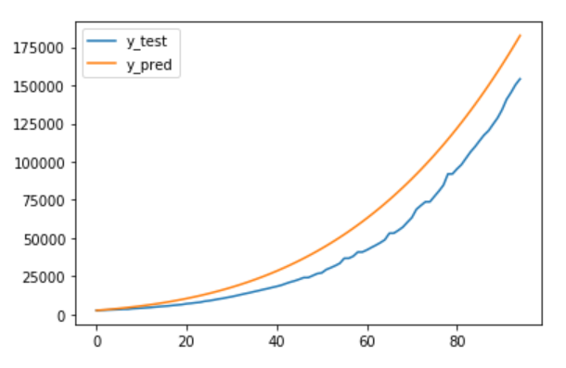
polynomial regression model Using the period of time to predict the number of infection in U.s.A, Colombia and brazil
U.S.A
Brazil
Colombia

Slide 12
Country Analysis:
Using data series in order to create a countries classifications by death per million (DPM)

Slide 13
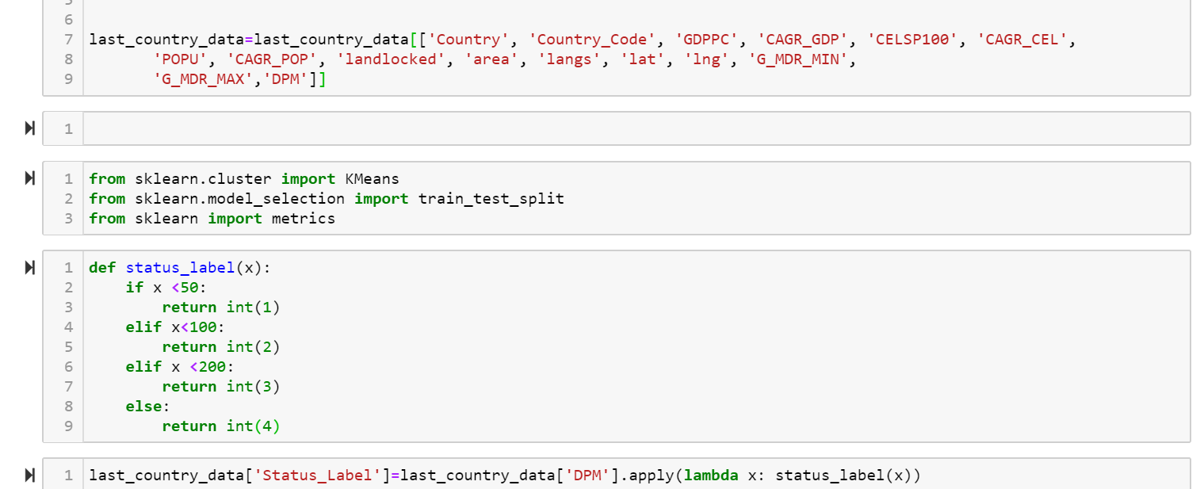
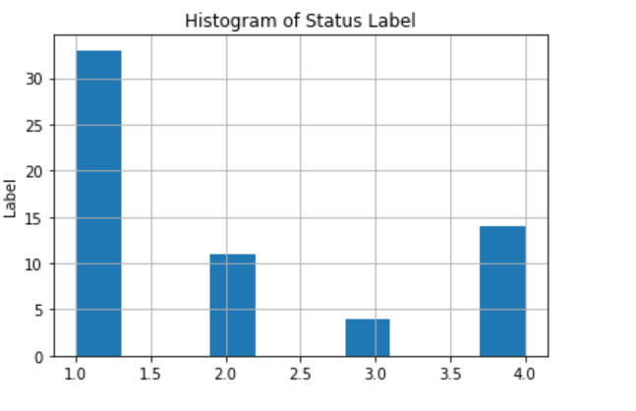
Country Analysis:
DPM
Country Population
Global Mobility Report.
Cellular Used
Number of death
ETL process
Status_label

Slide 14
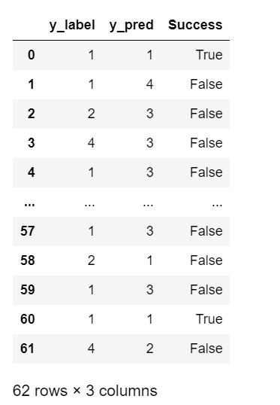
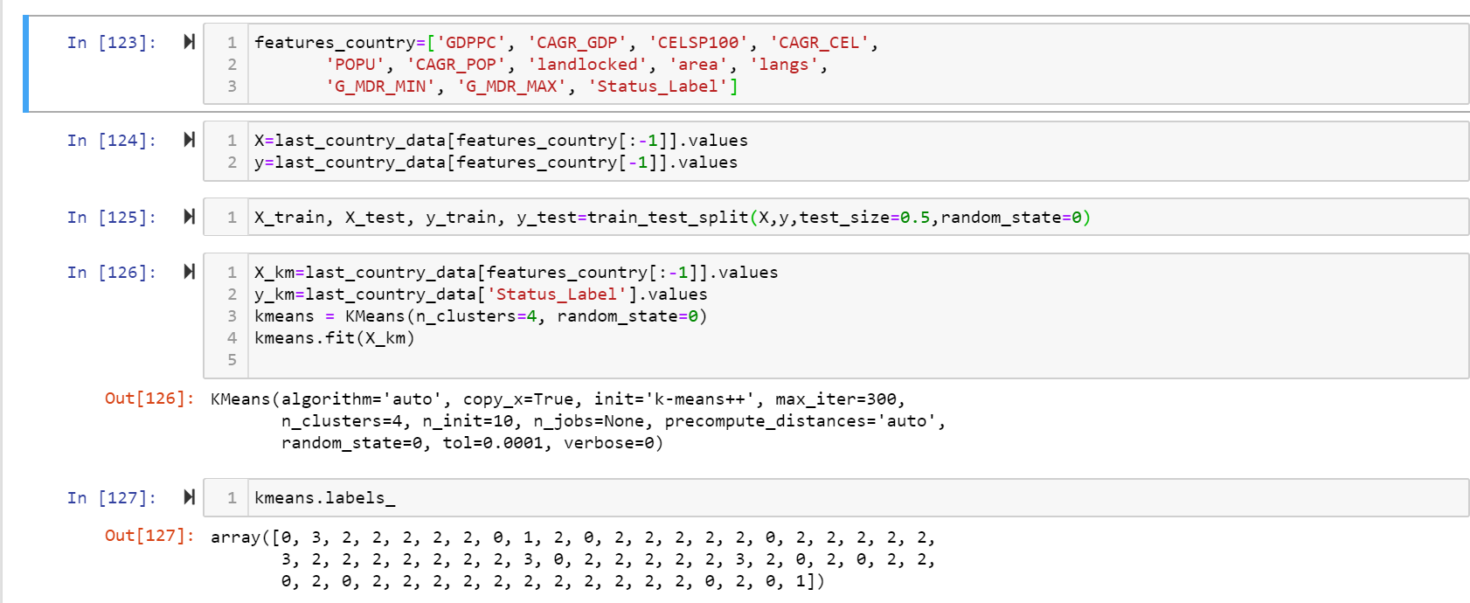
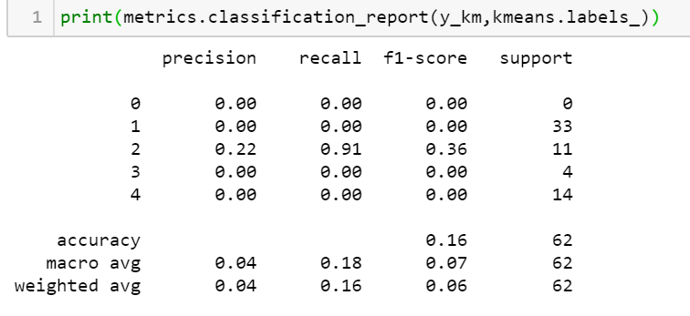
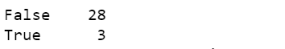
Kmeans model
classifications by death per million (DPM)

Slide 15
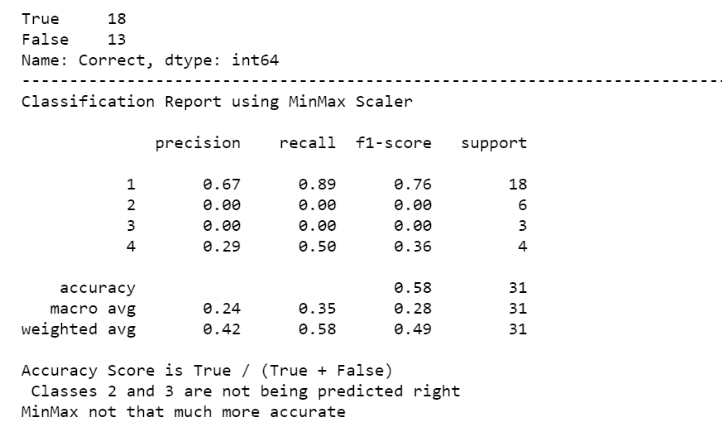
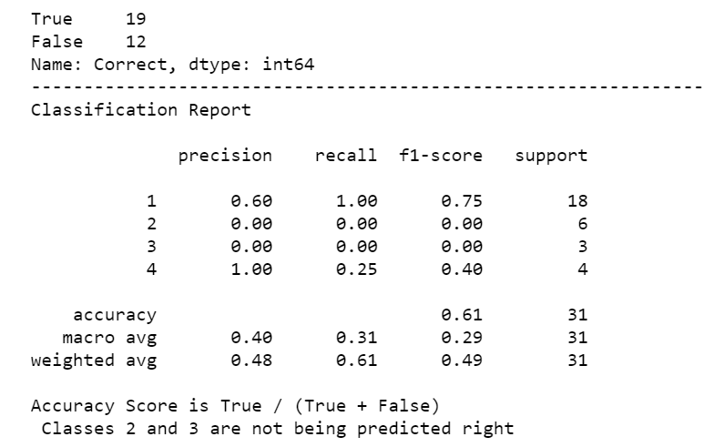
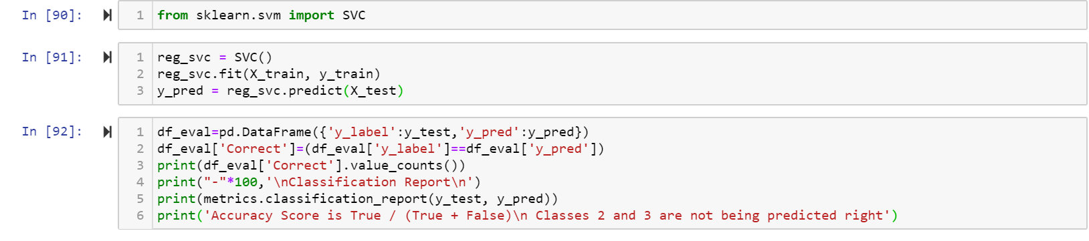
SVC model
classifications by death per million (DPM)

Slide 16
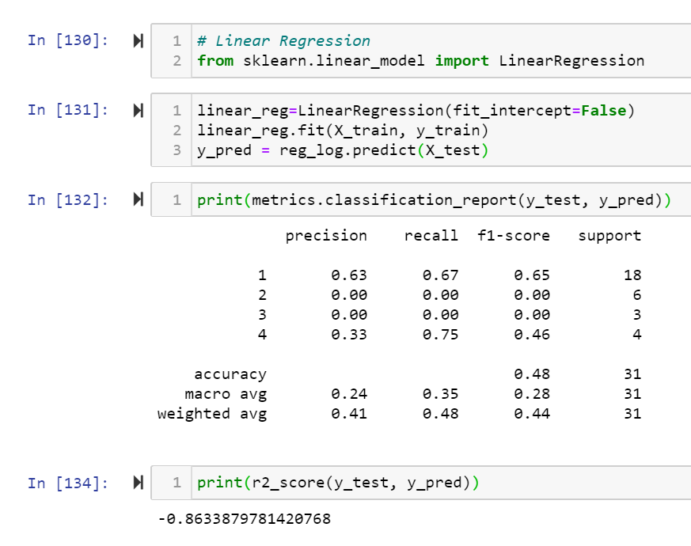
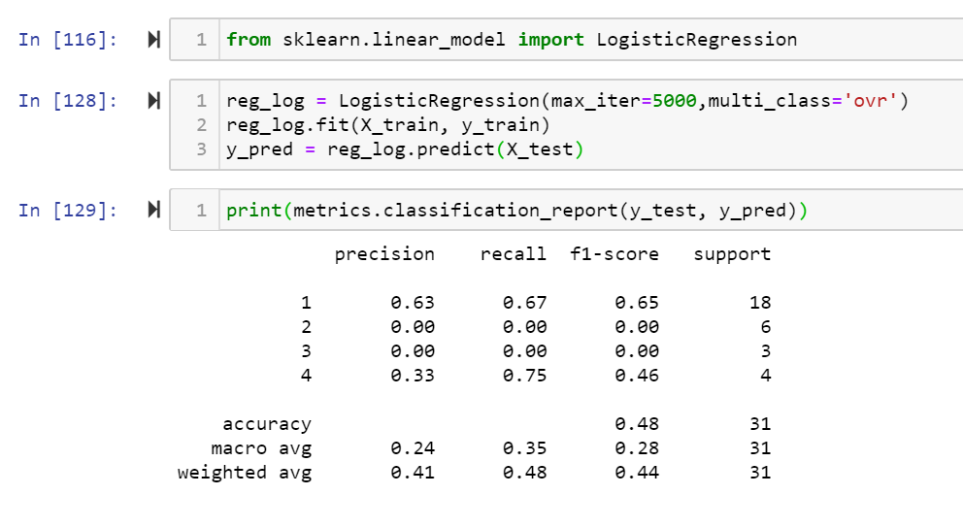
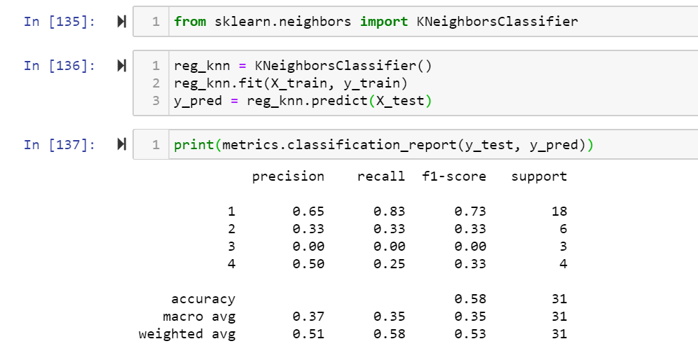
classifications by death per million (DPM)
Lineal Regression
Logistic Regression
Kneighbors Classifier

Slide 17
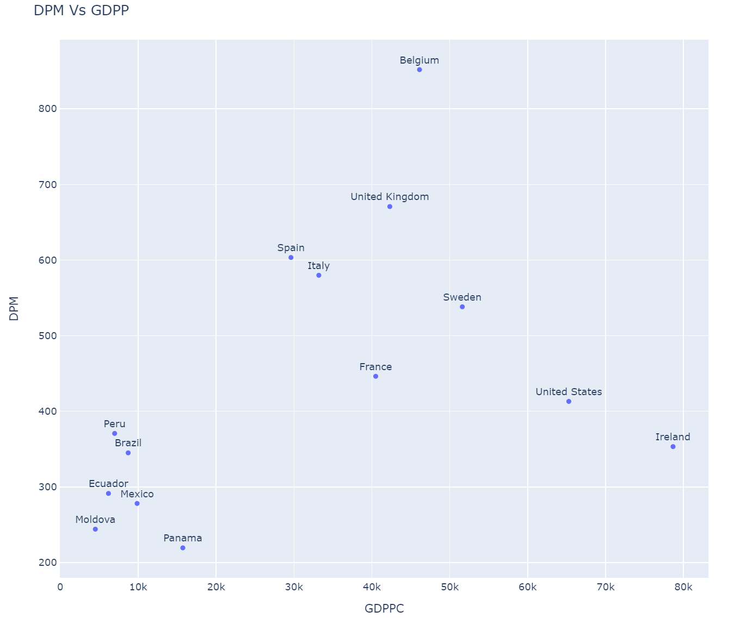
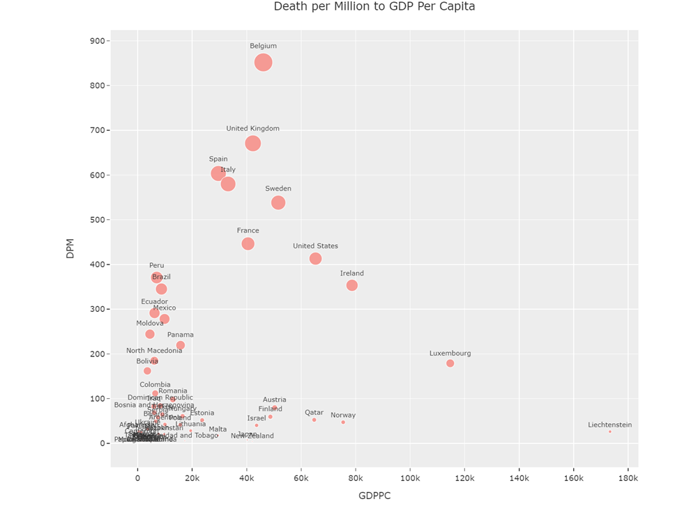
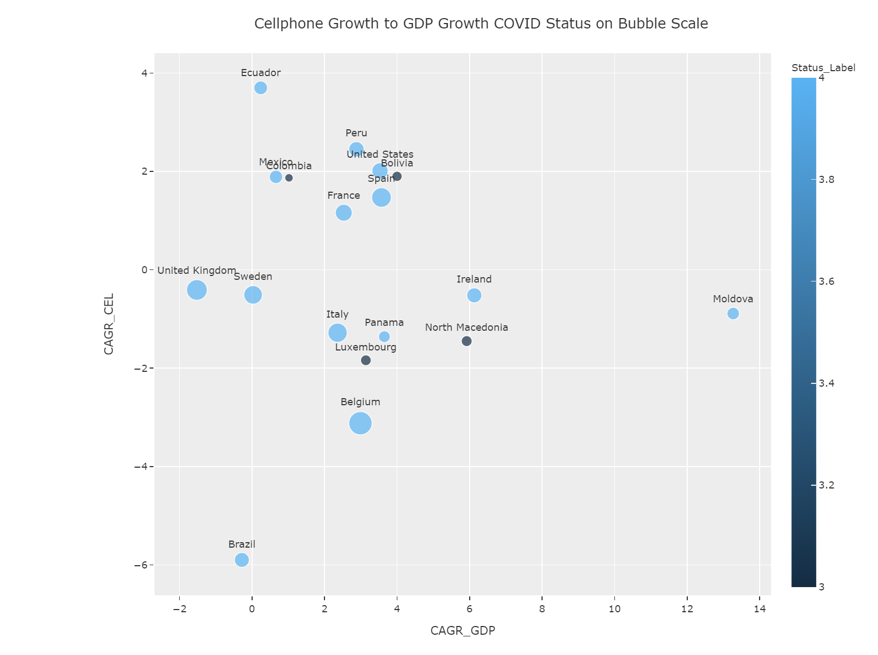
classifications by death per million (DPM)

Slide 18
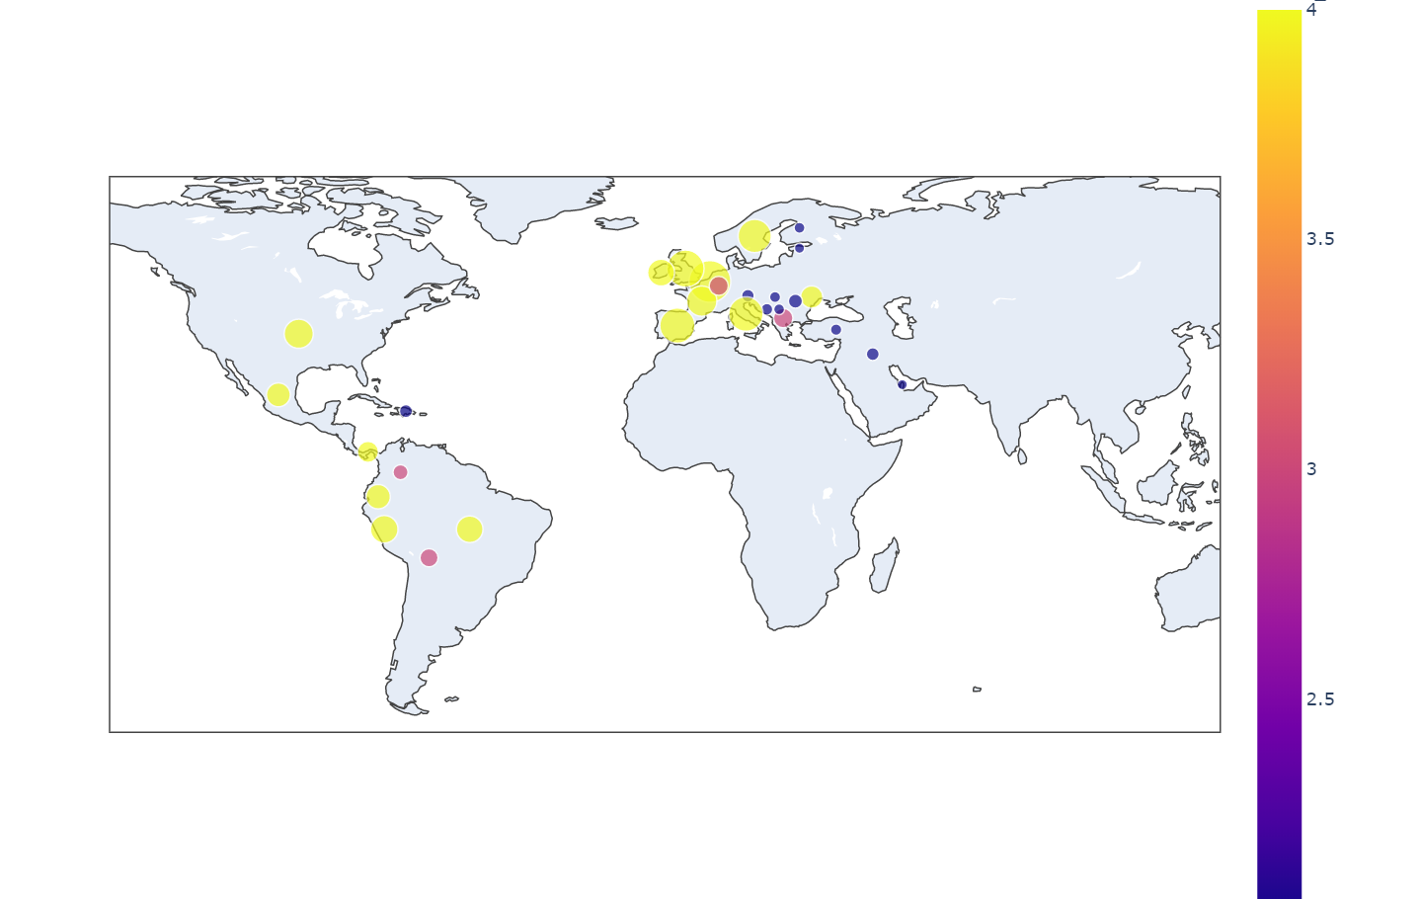
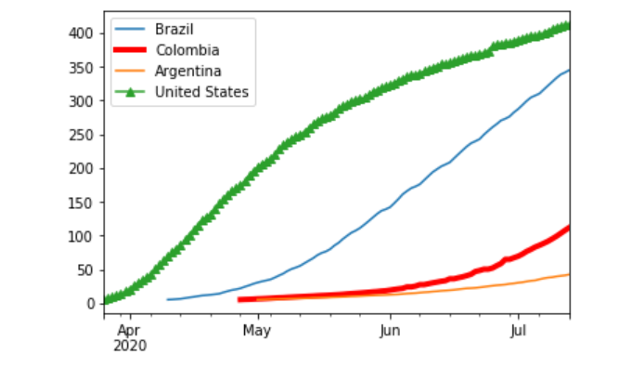
classifications by death per million (DPM)

Slide 19
Time Period – (Days since first 5 DPM) VS Death Per Million'

Slide 20
Correlations

Slide 21

Conclusions
The contagion of the disease makes the data not stationary
Our models show how the data has a drastic change , this breaks the model. this phenomenon is called regime change.
A machine learning model needs time to adapt to the stationary statistics. If the statistics change rapidly, we need to implement a model that adapts to how the data is changing. These models are called dynamic model
“Machine learning: the best predictive performance usually a combination of shallow and deep learning”

Slide 22


Thanks

